Slide 1
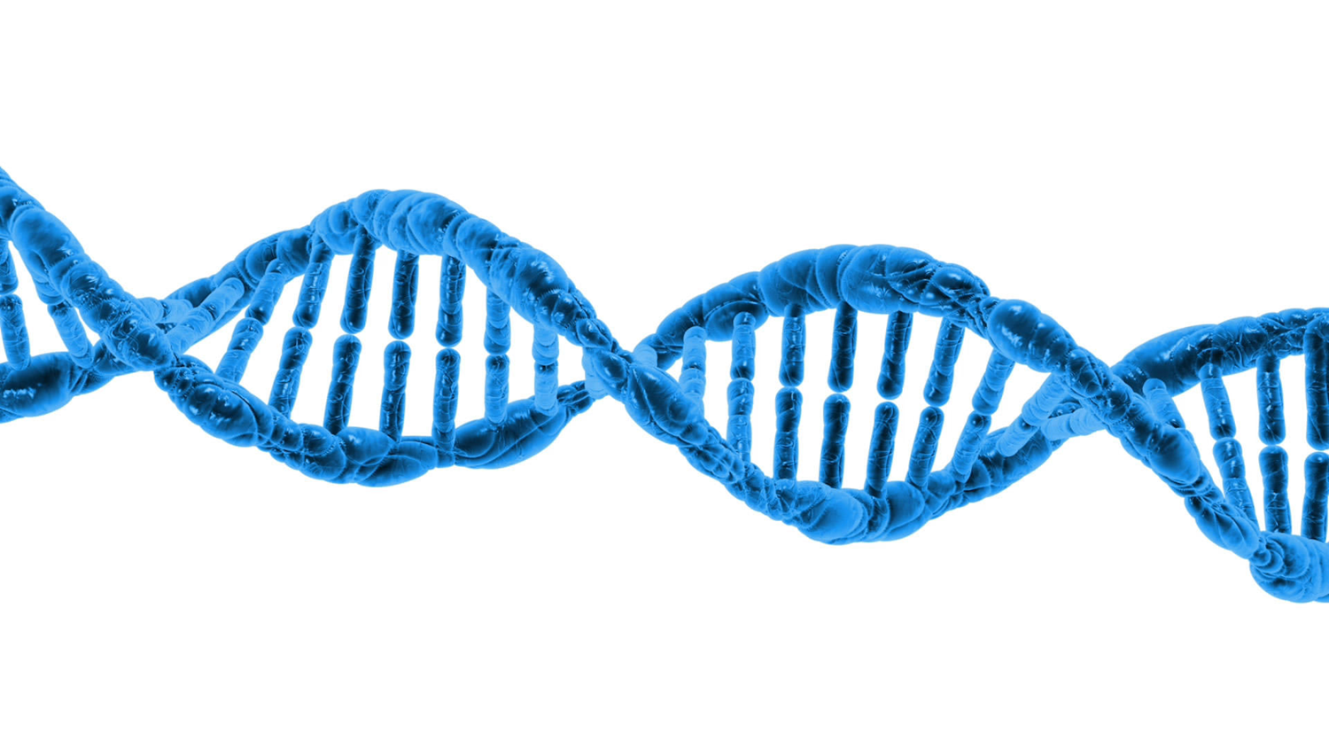
Introduction to DNA
We will refresh cell structure and introduce DNA as the unit of hereditary information
Notes:
Insert cover image and use transparency settings to fade image.

Slide 2
Do not delete this slide.
This slide is designed so that you can copy the prompt box you need and insert it into your slides.
This slide is hidden and will not be included when presenting your lesson.
TRACK WITH ME
VOCABULARY
1 -
HINT
Students, remember….
CHECK FOR UNDERSTANDING
READ WITH ME
TEACHER CUE
MAKE THE CONNECTION
Students, you already know….
EXTENSION
GESTURE WITH ME

Slide 3
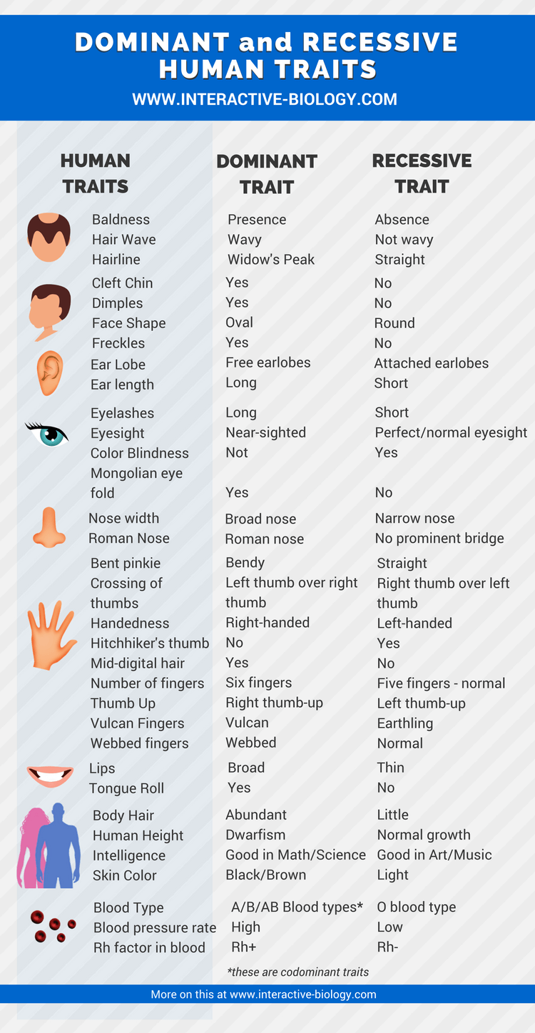
For each of the following human traits, circle whether you show the dominant trait or recessive trait
When finished, glue it in your book (under today's title and date)

Slide 4
We will refresh cell structure and introduce DNA as the unit of hereditary information
TRACK WITH ME
READ WITH ME
We will be able to describe basic cell structure
We will be able to complete the what we know activity
We will be able to explain the function of DNA
DECLARE THE OBJECTIVE
Read the learning objective to your partner.
Notes:
Learning Objectives contain concepts (nouns, big ideas), skills (verbs, measurable behaviours) and sometimes context (restricting or targeting conditions).
●Example: Students will be able to describe the concept of density and apply it to floating and sinking.
●
Success criteria are specific measurable outcomes that if met mean that the student has met the learning objective.
Examples:
•Students will be able to compare densities of substances using mass and volume.
•Students will be able to identify whether a solid or liquid will float or sink in a liquid based on their densities.

Slide 5
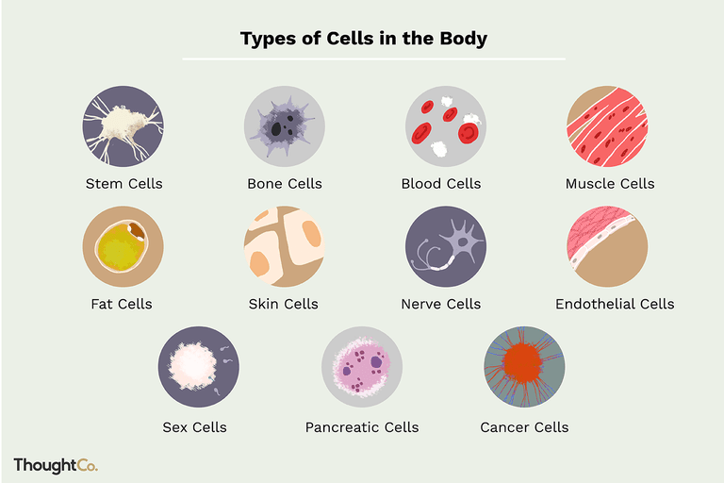

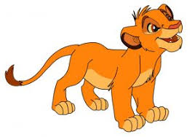
We will refresh cell structure and introduce DNA as the unit of hereditary information
CHECK FOR UNDERSTANDING
What features do all vertebrates have in common?
Cell Theory
All living things are made of cells.
Cells are the basic building blocks of life.
Notes:
Diagram from https://www.ck12.org/book/CK-12-Biology-Concepts/section/12.2/
https://www.britannica.com/animal/vertebrate

Slide 6
We will refresh cell structure and introduce DNA as the unit of hereditary information

Slide 7
We will refresh cell structure and introduce DNA as the unit of hereditary information

Slide 8
We will refresh cell structure and introduce DNA as the unit of hereditary information
Main components of cells
Membrane: encloses cells, provides a barrier for material to pass
Cytoplasm: maintains shape
DNA: holds genetic information

Slide 9
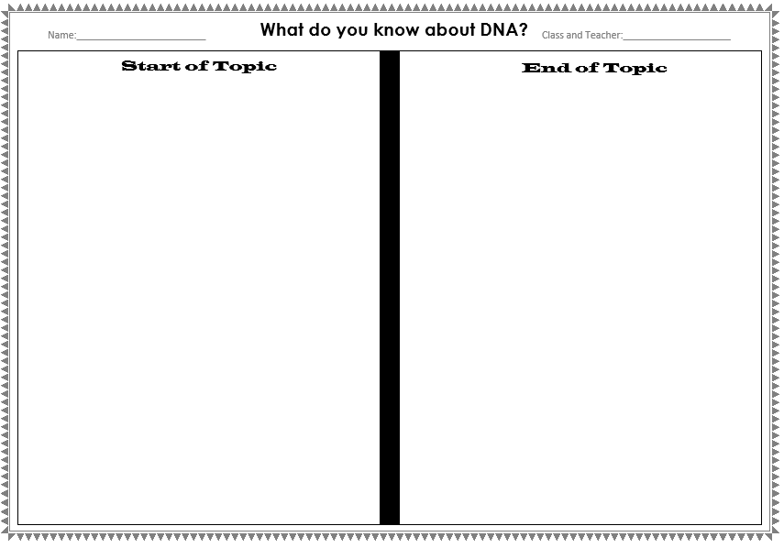
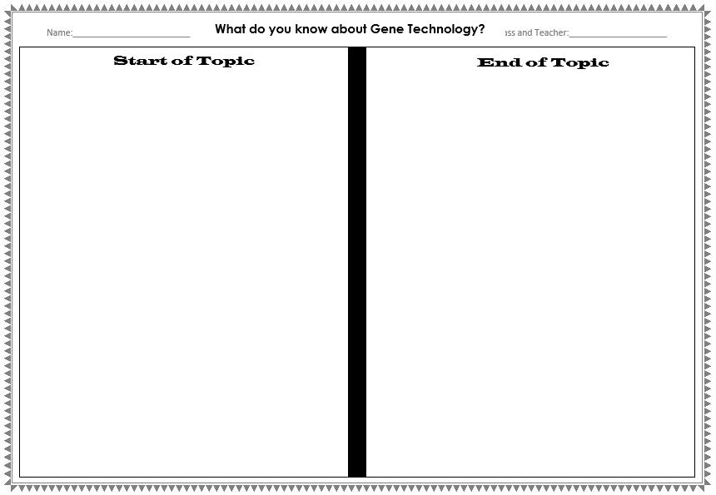
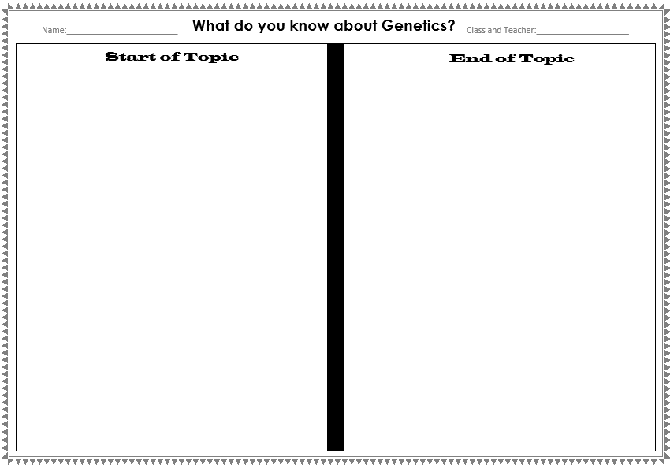
We will refresh cell structure and introduce DNA as the unit of hereditary information
What do you know about DNA and Genetics?
Conceptual Diagnostic Task

Slide 10
What do you know about DNA and Genetics?

Slide 11
What do you know about DNA and Genetics?

Slide 12
What do you know about DNA and Genetics?

Slide 13
This is a cell. We are going to zoom in on it multiple times.
Cell

Slide 14
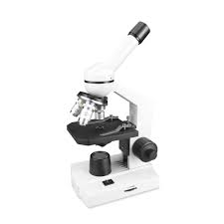
This is a cell. We are going to zoom in on it multiple times.

Slide 15
This is a cell. We are going to zoom in on it multiple times.
Nucleus

Slide 16
We will refresh cell structure and introduce DNA as the unit of hereditary information
Nucleus
Holds all DNA and genetic information
Enclosed by a nuclear membrane
“Controls cell activity”
More specifically – controls protein production

Slide 19
CHECK FOR UNDERSTANDING
How many total chromosomes do humans have? Can you have less or more?
We will refresh cell structure and introduce DNA as the unit of hereditary information
Chromosome
Tightly wound package of DNA and proteins
Humans have 23 pairs of chromosomes
Teacher Cue
Animal chromosome numbers range from 254 in hermit crabs to 2 in a species of roundworm. The fern called Ophioglossum reticulatum has 1260 chromosomes! Humans have 46, chimpanzees have 48, and yes, potatoes also have 48.

Slide 22
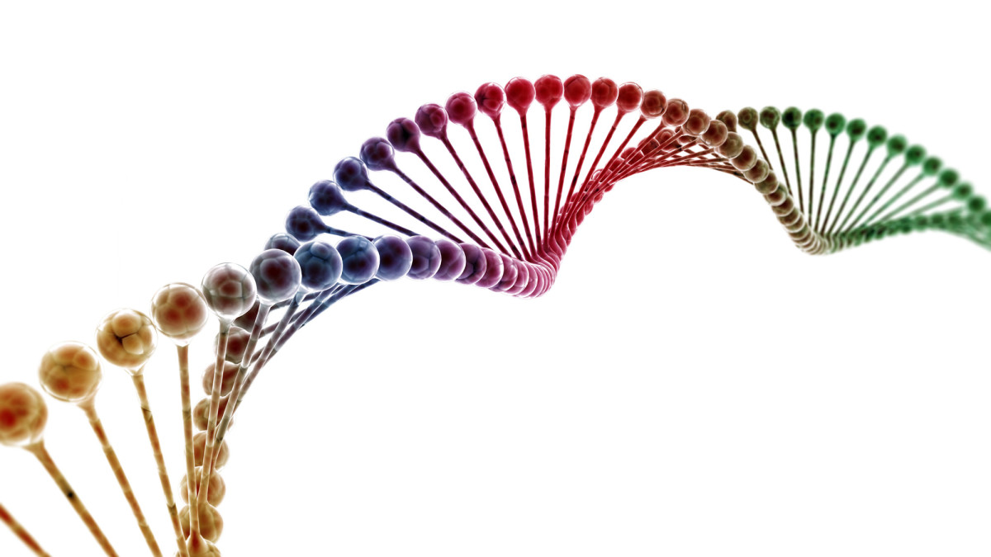
We will refresh cell structure and introduce DNA as the unit of hereditary information
DNA (Deoxyribonucleic acid)
is a thread-like chain that carries the genetic instructions used in the development and functioning of all living organisms
“Blue-print of life”

Slide 24
We will refresh cell structure and introduce DNA as the unit of hereditary information
Gene
Each gene codes for a specific trait

Slide 25
DNA is present in each and every cell of human body.
Each DNA strand is 1.8 meters long but squeezed into a space of 0.09 micrometers.

Slide 26
If someone manages to unwind all DNA molecules in a human body and place them end to end, the total length that can be covered is 16 billion kilometres! That’s the distance covered in a trip from Earth to Pluto and back – and then Earth to Uranus and back!

Slide 27
Human DNA is 95% identical to the DNA of chimpanzees.
That’s quite understandable but what’s shocking is that human DNA is 50% identical to the DNA of bananas!
CHECK FOR UNDERSTANDING
Check Success Criteria.

Slide 28
We will refresh cell structure and introduce DNA as the unit of hereditary information
TRACK WITH ME
READ WITH ME
We will be able to describe basic cell structure
We will be able to complete the what we know activity
We will be able to explain the function of DNA
DECLARE THE OBJECTIVE
Read the learning objective to your partner.
Notes:
Learning Objectives contain concepts (nouns, big ideas), skills (verbs, measurable behaviours) and sometimes context (restricting or targeting conditions).
●Example: Students will be able to describe the concept of density and apply it to floating and sinking.
●
Success criteria are specific measurable outcomes that if met mean that the student has met the learning objective.
Examples:
•Students will be able to compare densities of substances using mass and volume.
•Students will be able to identify whether a solid or liquid will float or sink in a liquid based on their densities.

